Slide 1

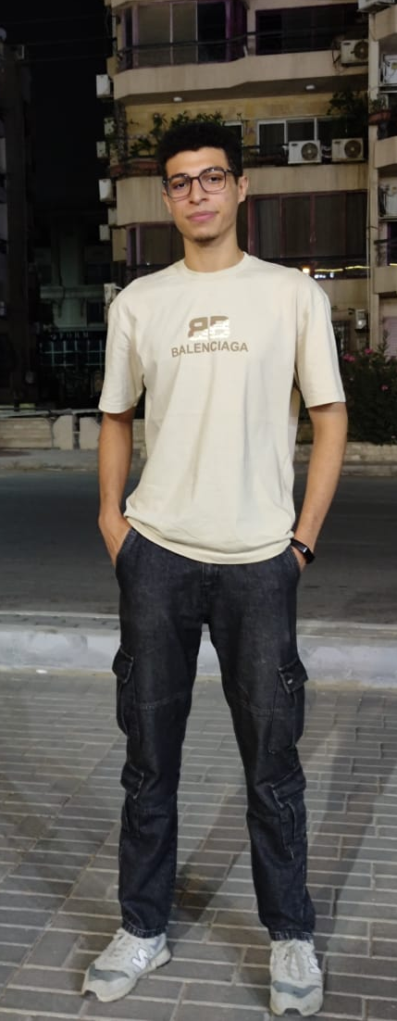




Software Testing Project Para bank + Restful booker

Slide 2

How it all started?
It all started with an email from a company that needed help testing its websites.
They were a startup, and like many startups, they didn’t even have an SRS document.
They weren’t sure if their systems were reliable.
Would customers be able to register?
Could money be transferred safely?
Would the APIs return the correct responses?
We were hired to find out.
So before testing, our first responsibility was to create the SRS ourselves — collecting requirements, analyzing every feature, and building a document the company can later update as their system grows.
Our mission was simple but critical:
Find every weakness, break the system, and make sure it behaves exactly as expected.

Slide 3


Testing
Manual
api
automation
Restful booker
Para bank

Slide 4
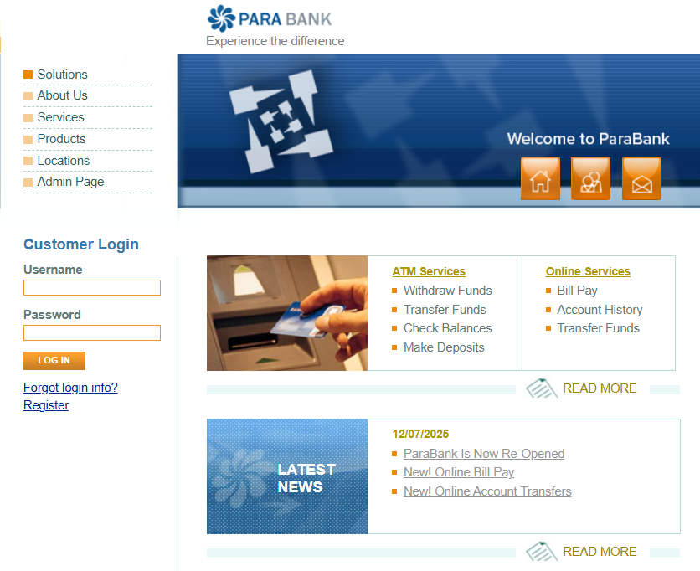
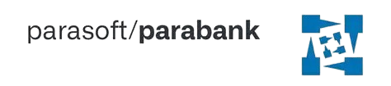
Para bank
Para bank
ParaBank is a demo online banking application.
It simulates real banking features such as account management, fund transfers, bill payments, loans, and profile updates.

Slide 5
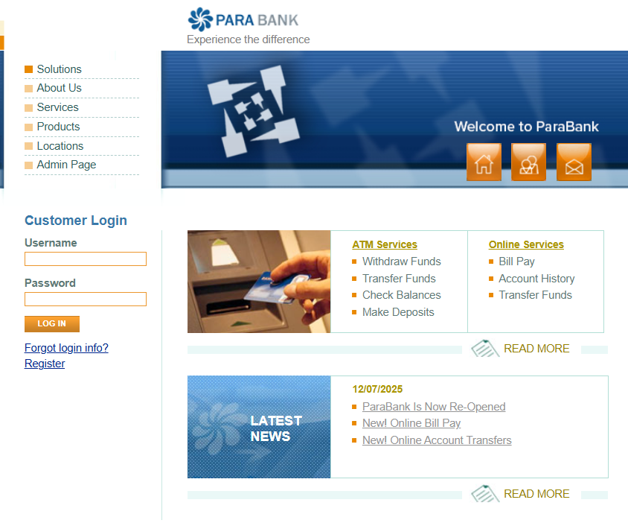
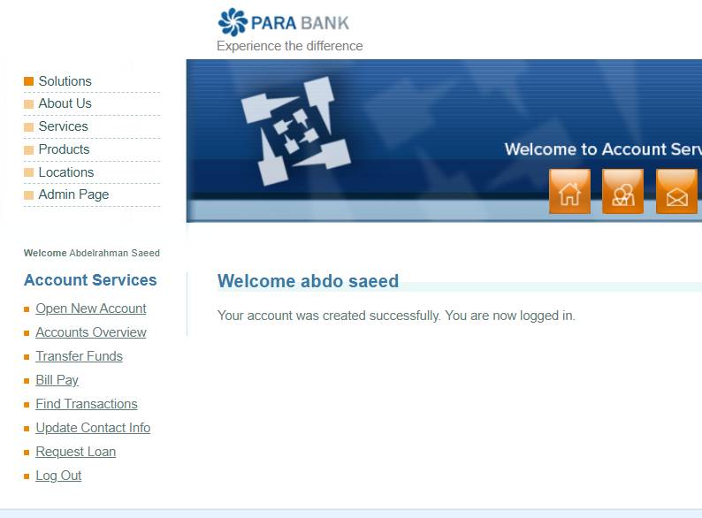
Manual testing
Para bank
Roles
Customer
Guest
Manager

Slide 6
Manual testing
Capabilities
Para bank
Roles
Manager
is an admin-level role that has full control over all customers and accounts.
Customer
is a registered user who can log in and perform personal banking activities.
They have access only to their own accounts, not to other users' accounts.
Guest
A new visitor curious about the system
is an unregistered user who is not logged into ParaBank.
They have very limited access and cannot perform any banking actions.

Slide 7
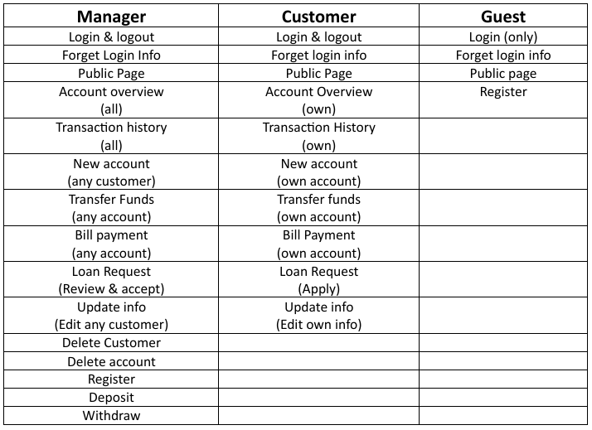
Manual testing
Para bank
Capabilities

Slide 8
Automation Testing
Para bank
Manual testing
Feature Ownership & Task Distribution
Abdelrahman Saeed | Public page(All) , Forgot Login Info(Manager) , Forgot Login Info(Customer) , Forgot Login Info(Guest) , Login(Manager) , Login(Customer)
Nour El-Din Kamal | Request Loan(Manager) , Request Loan(Customer) , Delete account(Manager) , Delete Customer(Manager) , Logout
Mohamed Reda Sakr | Deposit(Manager) , Withdraw(Manager)
Mohamed Ali Khalil | Register(Manager) , Register(Customer) , Transfer Funds(Manager) , Transfer Funds(Customer) , Find Transaction(Manager) , Find Transaction(Customer)
Mohamed Alaa Eldin Omar | Open New Account(Customer) , Open New Account(Manager) , Bill Payment(Manager) , Bill Payment(Customer) , Update Contact info(Manager) , Update Contact info(Customer)
Rodina Mohamed

Slide 9


Automation Testing
Para bank
For automation, we focused only on Customer features.
We automated essential test cases using Eclipse with Selenium and TestNG.
The goal was to validate the core user flows efficiently and ensure consistent behavior.

Slide 10
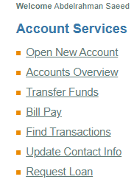
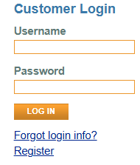
Automation Testing
Para bank
Features to test
Login
Register
Forget login info
Bill payment
Open new account
Fund transfer
Find transaction
Update contact info
Request loan

Slide 11
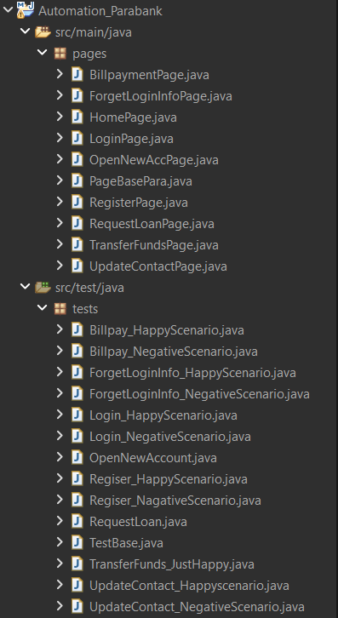
Automation Testing
Para bank
Feature Ownership & Task Distribution
Abdelrahman Saeed | Register , Sign in
Nour El-Din Kamal | Forget login info , open new account , transfer funds , request loan
Mohamed Reda Sakr | Bill Payment
Mohamed Ali Khalil | Update contact info
Mohamed Alaa Eldin Omar | Find Transaction
Rodina Mohamed

Slide 12

API
RESTFUL BOOKER
After testing the UI of Parabank, my work wasn’t finished yet.
The company also needed to make sure their API-based system, Restful Booker, was functioning correctly.
Unlike Parabank, this system has no buttons, no pages, and no user interface.
Everything happens through API requests — meaning the only way to communicate with the system is by sending data and receiving responses.
So I switched from UI testing to API testing using Postman, where every request became like a message I sent to the server, and every response was a clue that helped me verify how the system behaved.

Slide 13

API
RESTFUL BOOKER
Restful Booker is a demo hotel booking API used for testing and training.
It doesn’t have a website or a user interface — everything works through API endpoints.

Slide 14
features
Create Token
Get Booking Ids
Get Booking
Create Booking
Update Booking
Partial Update Booking
Delete Booking
Health Check

Slide 15
API
RESTFUL BOOKER
Feature Ownership & Task Distribution
Abdelrahman Saeed | Get booking id , Create token
Nour El-Din Kamal | Get booking , Health check
Mohamed Reda Sakr | Delete booking , partial update booking
Mohamed Ali Khalil | Create booking
Mohamed Alaa Eldin Omar | Update booking
Rodina Mohamed

Slide 16
Conclusion
Throughout this project, we worked as a full QA team — starting with creating an SRS for a startup that had no documentation.
We validated ParaBank through manual and automation testing, and ensured the reliability of Restful Booker through API testing.
This project allowed us to practice real-world QA workflows including requirement gathering, test planning, test execution, defect reporting, and task distribution.”

Slide 17

In the end, we delivered a complete testing solution — from documentation, to UI testing, to automation, to API validation.

